Slide 1


VISVESVARAYA TECHNOLOGICAL UNIVERSITY
JNANA SANGAMA BELAGAVI - 590 018, KARNATAKA.
Department of Computer Science & Engineering
Industry Internship [CS82231C] presentation
Under the Guidance of
Presented by
Mrs. Vidya V V
Associate Professor,
Dept of CS&E
SHREYA K
4SF22CS204
AY-2025-26

Slide 2

Internship Completion Certificate/ Intermediate Certificate
Department of
Computer Science & Engineering

Slide 3
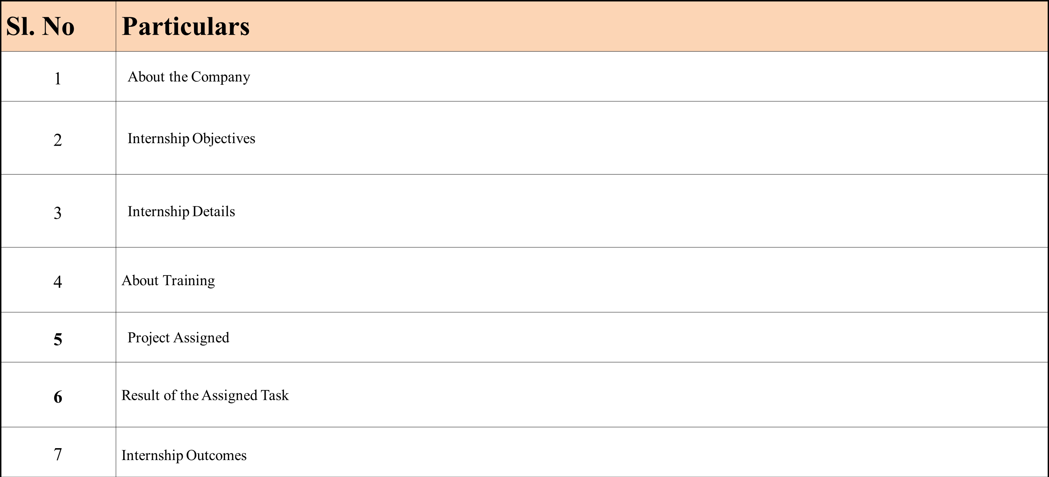
Table of Contents
Department of
Computer Science & Engineering

Slide 4
Internship Objectives
Department of
Computer Science & Engineering
To reduce the gap between academia and industry
To achieve real world work experience.
To learn advanced techniques associated to related field.
To enhance skills and techniques.

Slide 5
About the Company
Department of
Computer Science & Engineering
Service areas
Managed Security Operations Center (MSOC)
Managed Network Operations Center (MNOC)
Security Incident and Event Management (SIEM)
Endpoint Detection and Response (EDR)
Network Access Control (NAC)
Data Loss Prevention (DLP)
Identity and Access Management (IAM)
Privileged Access Management (PAM)
Cloud Security & Services
Cyber Security Controls Assessment Audit
Vulnerability Assessment and Penetration Testing
Patch Management
Web development

Slide 6
Major Product
Cyber Safe Girl
Cyber Safe Girl is a unique program inspired by the honorable Prime Minister Narendra Modi ji's "Beti Bachao, Beti Padhao". The mission of this project is "Beti Bachao Cyber Crime Se", designed to inculcate the best practices of responsible browsing and stay safe and secure from the cyber threats, especially among the students, elderly and working professionals. Cyber Safe Girl is an E-Learning Program, containing 70+ animated infotoons, explained in detail by Dr. Ananth Prabhu G.
Traxelon (Tactical Recovery & Analytics eXchange for Enforcement & Law‑Oriented Networks)
A specialized intelligence platform built for law enforcement agencies to conduct covert digital surveillance operations with precision and legality.
TRAX – Trace, Tracking, Trajectory
ELON – Electron, Element, Echelon, Elon MUSK
Department of
Computer Science & Engineering

Slide 7
Internship Details
Department of
Computer Science & Engineering
Start date – 15 January 2026
End date – 7 May 2026.
Total duration – Sixteen (16) Weeks
Position – Web Developer Intern
Lead (mentor name) – Mr Shravan Kumar U K
Office hours – 9am to 4pm
Office days – Monday to Friday
Team size – 07
Role in the Team - Web Developer

Slide 8
Traxelon
Traxelon is a real-time person and vehicle tracking web application developed at TorSecure Cyber LLP, designed for law enforcement. It enables police departments to monitor suspects, vehicles, and field officers through a centralized digital dashboard.
Target Users : Law enforcement agencies, police departments, and government security units across India.
Features :
1. Real-Time Location Tracking
Live GPS-based tracking of registered persons and vehicles on an interactive map with minimal latency.
2. Search & Filter Module
Officers can search by suspect name, ID, or vehicle registration number with filters for location, status.
3. Movement History & Route Replay
Time-stamped movement logs with route replay to reconstruct past movements during criminal investigations.

Slide 9
4. Geofencing Alerts
Automatic alerts triggered when a tracked entity enters or exits a custom-defined virtual boundary zone.
5. Role-Based Access Control
Sensitive data is accessible only to credentialed officers based on their role and clearance level.
Tech stack
1. Frontend : React.js for a dynamic, responsive interface; Leaflet.js / Google Maps API for interactive live maps.
2. Backend : Node.js handle authentication, API routing, and real-time data processing.
3. Database : Firebase
4. Security : JWT-based authentication, HTTPS encryption, and role-based access control protect all data and sessions.
5. Deployment : Deployed the application on Vercel and connected a custom GoDaddy domain for live production hosting.

Slide 10
Results - Traxelon (Operational Impact)
Traxelon was successfully developed and deployed on https://traxelon.com/
Improved Officer Safety
Field officers were monitored in real-time by the control room, enabling quick backup in high-risk situations.
Live tracking reduced risks of solo surveillance by keeping command centers informed of officer positions.
Reduced Manpower Requirements
A single operator could monitor multiple agents and suspects simultaneously, reducing need for large surveillance teams.
Manual check-ins and physical log maintenance were replaced with automated digital records.
Pattern-Based Crime Prevention
The system helped police identify movement patterns, enabling proactive crime prevention not just reactive response.

Slide 11
Results - Traxelon (System Performance)
1. Platform Stability
Stable performance under concurrent user load with minimal latency
2. Ease of Use
Intuitive dashboard; minimal training required
Responsive design supported desktop and laptop access
3. Data Accuracy & Security
High GPS positional accuracy with role-based access for confidentiality
4. Recognition
Commended by mentor Mr. Shravan U Kumar for practical applicability and technical execution

Slide 12
Internship Learning Outcomes
Technical Skills Gained
Hands-on experience in Next.js, React, Tailwind CSS, Node.js, and Firebase
Implemented authentication systems - Clerk (AI VS ME) and Firebase Auth (Traxelon)
Practiced component-based architecture, REST API integration, and real-time data handling
Professional & Industry Exposure
Experienced working in an Agile team environment, participating in daily standups, code reviews, and sprint planning sessions.
Collaborated with teammates on feature integration and UI consistency
Problem Solving & Project Ownership
Owned the complete frontend from design to deployment
Debugged UI issues and delivered production-ready code under real timelines
Domain Knowledge
Applied AI to career intelligence and automation risk (AI VS ME)
Understood how technology contributes to public safety and law enforcement (Traxelon)

Slide 13
Thank You

